Slide 1
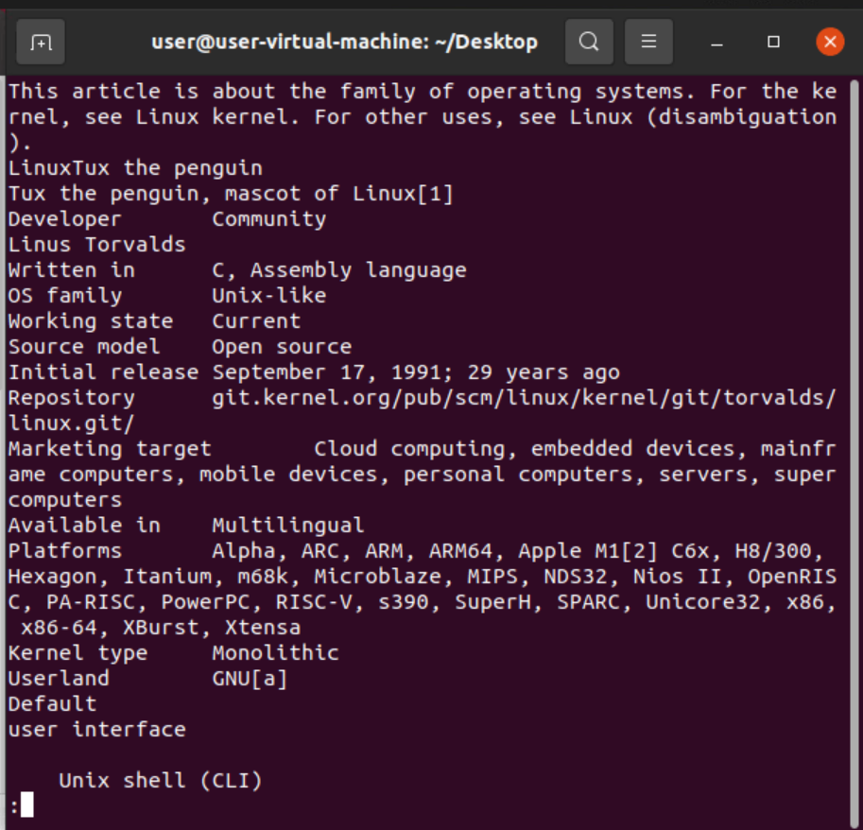
Linux Commands
1) $ less fn :- It will load the page one by one.
Note :- 1) p for previous.
2) Enter for next Line
3) Space for next page
4)Q for quit.

Slide 2
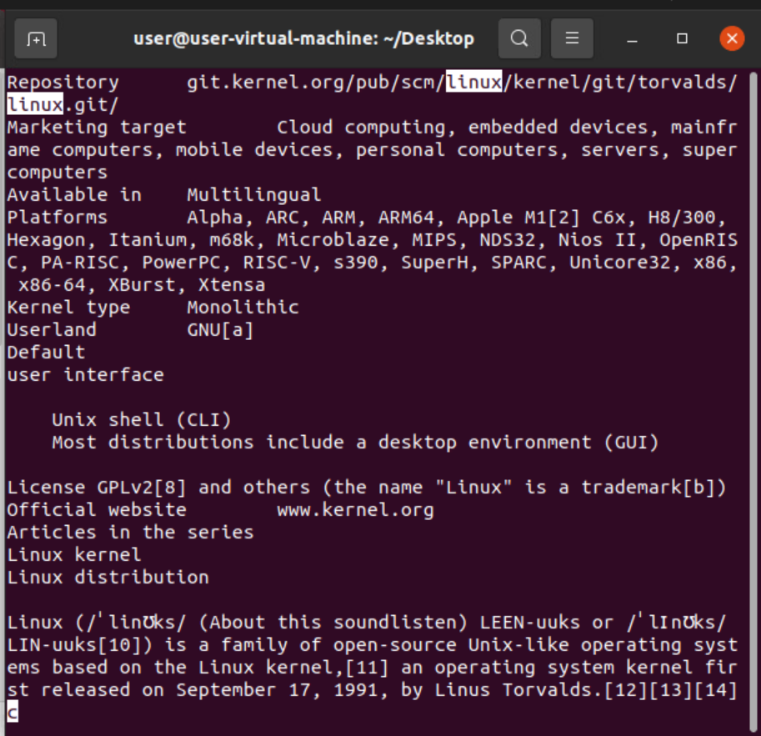
2) $ less –p 'word' fn :- It starts from word which you choose and highlights the word.

Slide 3
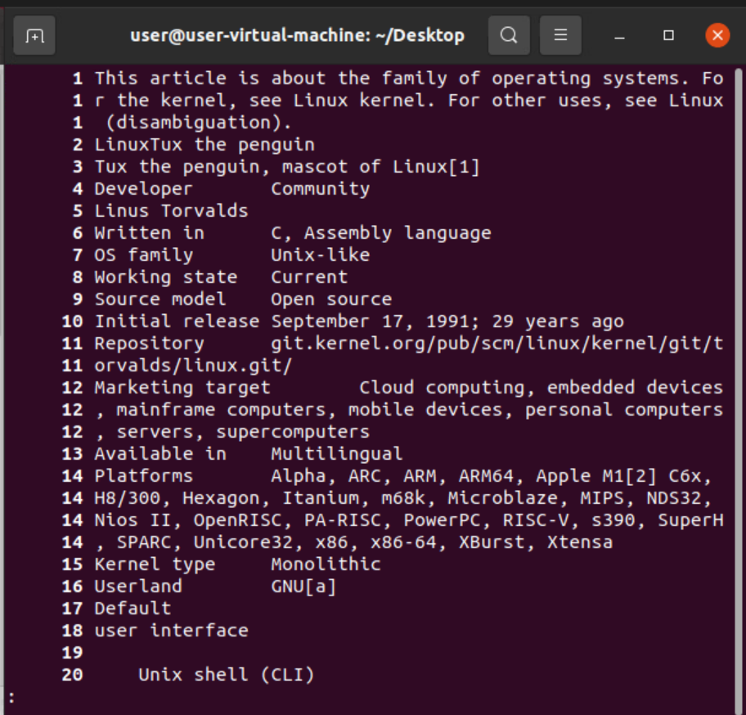
3)$ less –N fn :- Displays the content with line number.

Slide 4
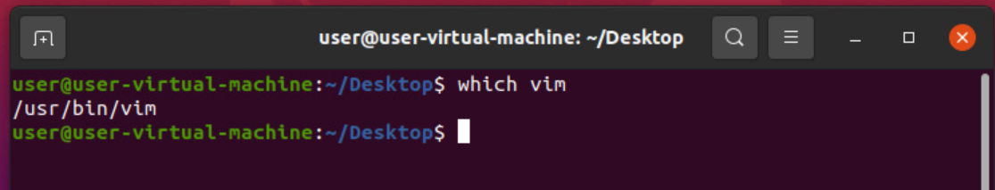
4)$ sudo apt install vim-nox :- Used to install vim editor using terminal.
5)$ which vim :- Used to see the vim is installed or not and also its shows the path.
6)$ vim :- Used to open the vim editor.

Slide 5
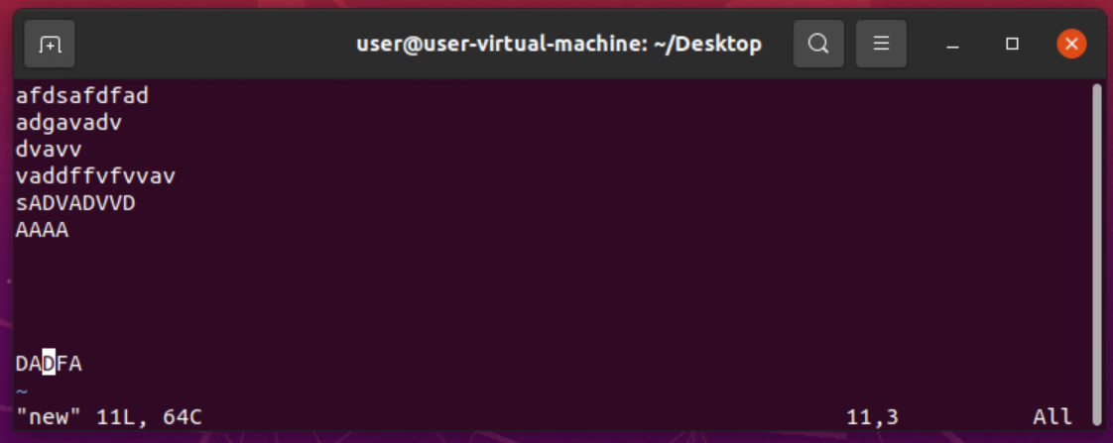
7)$ vim filename :- Used to open specific file in vim editor. After executing the command the result is.
Note :-- (i) is used to insert(editor mode).
(esc) used to exit from editor mode.
(dd) for delete line by line
(u) to undo the changes
(xx) used to delete word by word

Slide 6
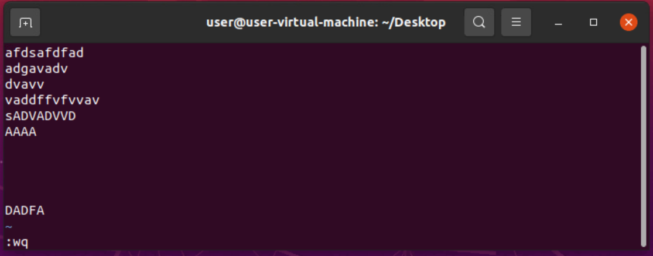
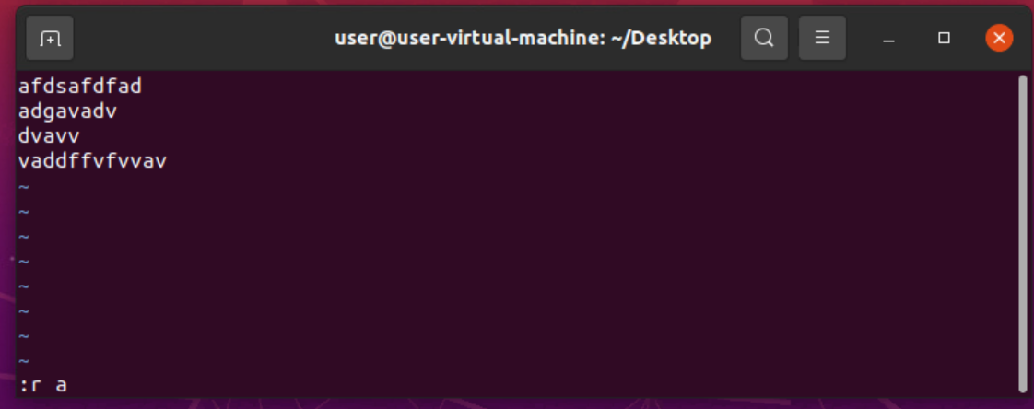
8) :wq :- is used to write the changes into the file and exit the editor.
If we use only w its saves the text and stays in vim editor.
9) :r filename :- used to read (or) open another file in editor .

Slide 7
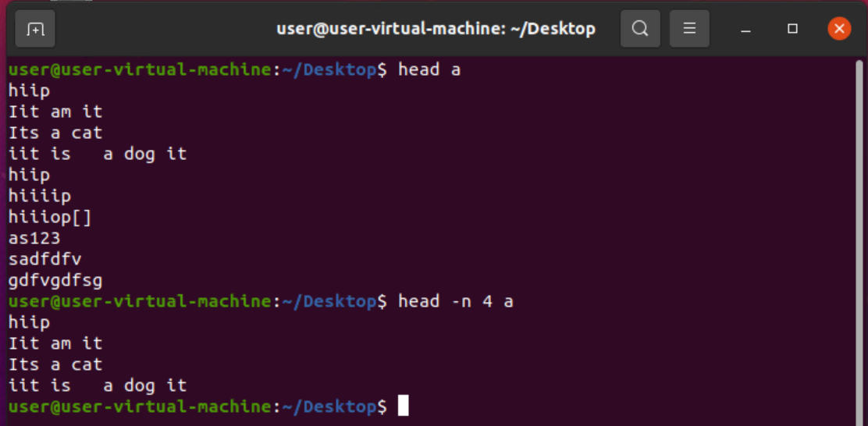
10) :q :- used to exit the vim editor
11) :q! :- used to exit without saving.
12) $ head filename :- Used to show the first 10 lines.
$ head –n 5 f1 :- Used to show the first 5 lines.
$ head –n 2 f1 f2 :- We can see first 2 lines in f1 and f2.

Slide 8
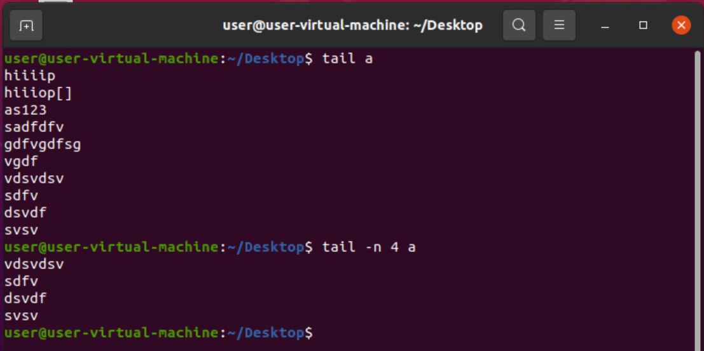
13) $ tail filename :- Used to show the last 10 lines.
$ tail –n 5 f1 :- Used to show the last 5 lines.
$ tail –n 2 f1 f2 :- We can see last 2 lines in f1 and f2.

Slide 9
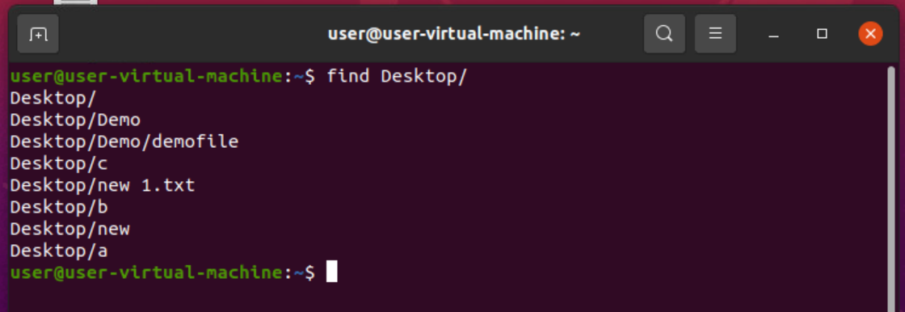
14) $ find a :- Used to see all paths present in the directory.

